Slide 1

Analysis report for
Workplace satisfaction survey
Keita Brudere, Viktória Szabó, Roy Liu

Slide 2

Background of the survey
The survey was conducted by interviewing 82 customers of our company
The survey measures the satisfaction of employees at their workplace, showing inputs of personal information as well
All the participants got a single candy for their effort

Slide 3


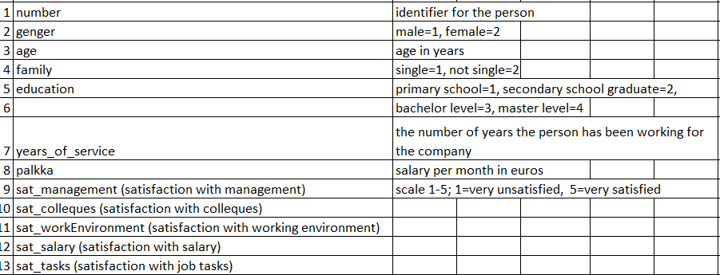
Variables of survey
Background variables: 1-9
Variables of main interest: 9-13 (Likert scale)
Categorical variables: gender, family, education,
Numerical variables: age, years of service, salary

Slide 4

Background analysis
Variable by variable

Slide 5
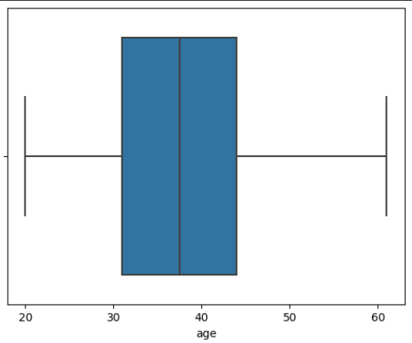
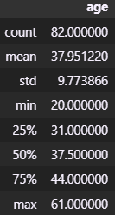
Keita’s slide (Age)
Graph 1
82 participants took part in this survey. The following graph represents age distribution amongst the workers.
As it can be seen in Table1, the oldest participant was 61 years old and the youngest was 20 years old.
The mean age of all participants were shown to be 38 years.
Out of 82 participants, 25% falls in the age group of 31 and younger, 50% falls below ~38 years, and 75% are 44 years old or younger.
Standard deviation (SD) suggests that the variability in the dataset is 9.8% .
Table1

Slide 6
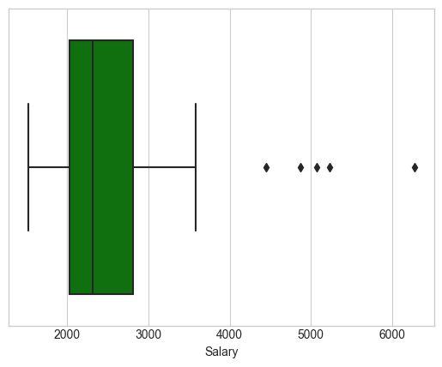
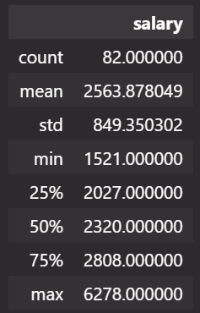
Salary (Roy)
82 people’s salary information has been gathered
As we can see from the graph, the majority amount of the salary falls in between 2000 and ~2800 with a few outliers as high as ~6200
The average salary is ~2500

Slide 7
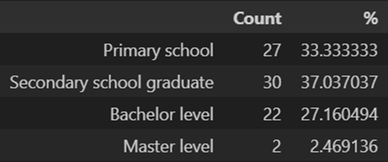
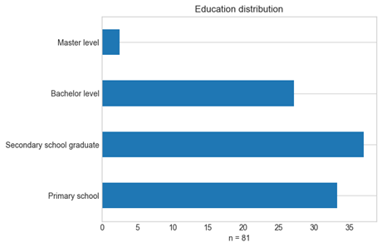
Education level (Viki)
Based on the survey the educational levels of our customers are distributed based on the percentage table shown here.
81 people made input regarding their education level
As shown on the distribution, the vast majority is made up by secondary school graduates (30 p / 37%)
The least percentage is made up by master’s level graduates. (2p / 2,5%)
University education together takes up less than either secondary or primary school graduates (bachelor + masters > primary + secondary)

Slide 8
Background analysis
Variable comparisons, reporting other relevant findings

Slide 9
Analysis of two variables
Here we will report analysis between variables of:
Age and gender
Family and salary
Education and years of service
Gender and salary satisfaction
Family status and salary satisfaction
Years of service and work environment satisfaction

Slide 10
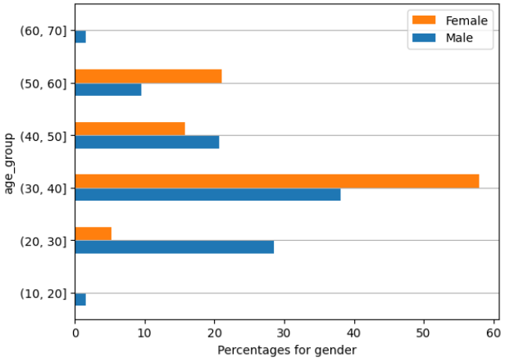
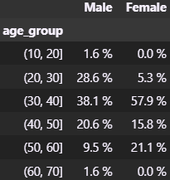
Comparisons Keita (Age / Gender)
Garph1 and Table1 represents the dependency between the age group and gender variables. It can be seen that male workers are mostly between the ages of 31 and 40. The same effect was found for female workers.
The p value between the age and gender values were found be insignificant p = .55 (See table 2). Meaning there is no significant relationship between the age of the workers and their gender.
Table 1
Graph1
Table 2

Slide 11
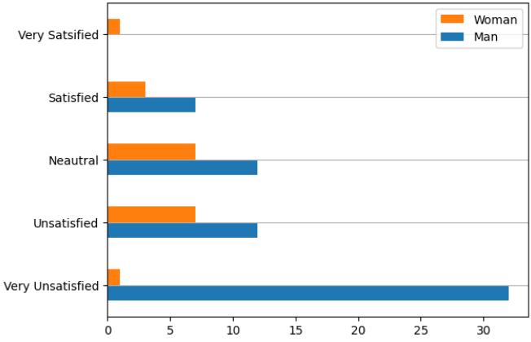
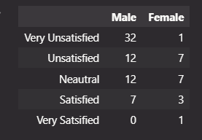
Keita's two variables (Salary satisfaction and gender)
After running analysis to determine whether there is a dependency between variables Gender and Salary satisfaction, the p value was found to be significant (p = .004). Suggesting that there is a significant difference between genders and satisfaction of the salary.
Table 1 and Graph 1 suggests that one female finds her salary very unsatisfying compared to 32 males. Whilst there is only one female who finds her salary satisfying compared to 0 men.
Table 1
Graph 1
Table 2

Slide 12
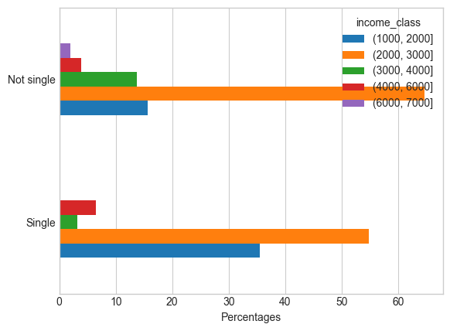
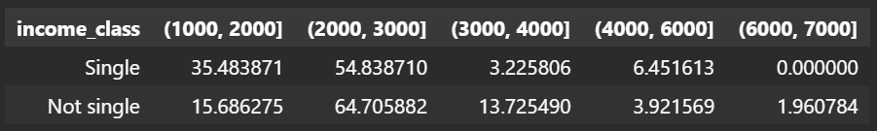
Analysis between family status and salary (Roy)
People who are single are making less salary compared to those who are not single according to the survey
Although, the P value is ~0.15, so it makes this comparison quite insignificant

Slide 13
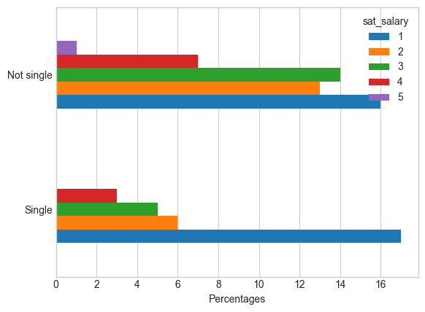
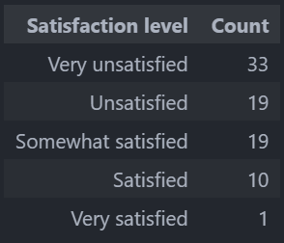
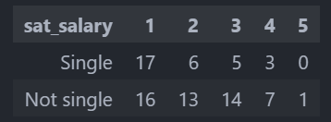
Family status and Salary Satisfaction (Roy)
Generally, people are not satisfied with their salary, majority being “very unsatisfied”
P value is ~0.29 and it makes this comparison insignificant

Slide 14
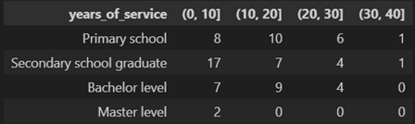
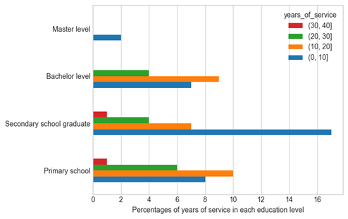
Analyzing dependency between variables education and years of service (Viki)
Here analyzed, whether there is dependency between variables education and years of service
As it is shown, the higher the education level, the lower the years of service is, which indicates that those participants, who quit education obtain more years of work experience
It seems that people who graduate secondary school are more likely to work then continue their path to higher education (17 people with fresh work experience)

Slide 15
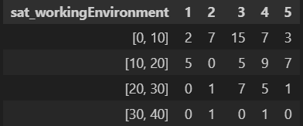
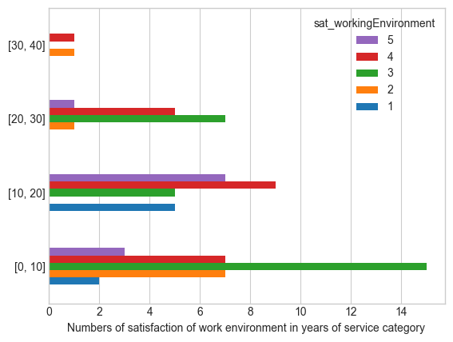
Analyzing dependency between variables years of service and working environment satisfaction (Viki)
Measures the satisfaction of working environment on a scale 1-5 amongst years of service categories
As presented, the vast majority of voters were among the less experienced peers
The more experienced attendees voted less, even then they give general answers
This indicates that newcomers to the job market would like to be seen and heard about their opinion, while older generations thend to be accepting towards working conditions and environment
The measure of p value is ~ 0.029, which proves the significancy of the analysis of these variables

Slide 16
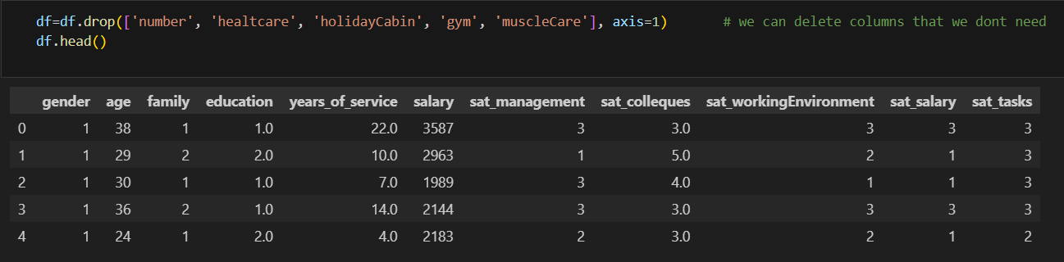
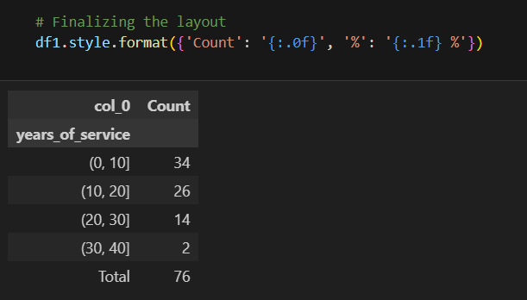
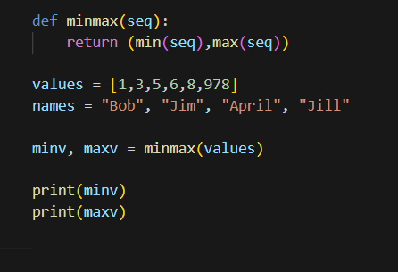
List comprehension
Slicing in WorkplaceSatisfactionSurvey
Keyword arguments

